Slide 1
Improving deep learning models with bag of tricks
Krzysztof Kolasiński, 12.12.2018

Slide 2
Disclaimer:
weakly coupled topics, so may be a little chaotic,
short summaries of interesting problems,
my random thoughts on those problems,
A rough plan of this presentation:
learning schedulers, batch size
optimizers
ZeroInit
mixup, label smoothing
etc

Slide 3
Modifying learning rate

Slide 4
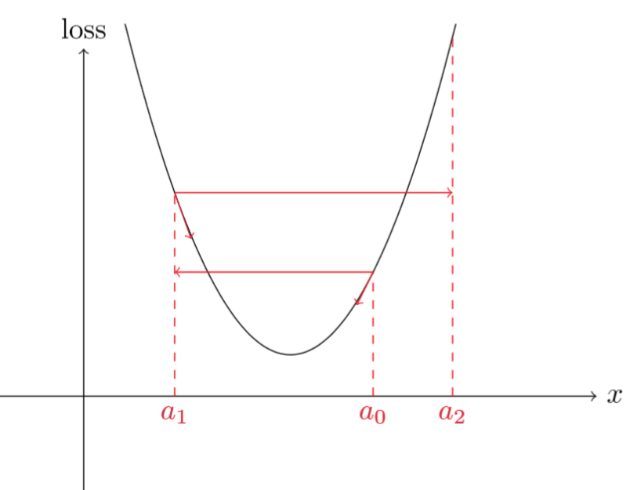
Selecting better learning rate
How to guess initial value for the learning rate?
large learning rate: risk of weight explosion
too small values: we will wait very long before we reach convergence, we can also
Note:
small LR may lead to bigger overfitting,
larger LR has regularizing property,
looking for the best one is a reasonable problem
Sources:
https://sgugger.github.io/how-do-you-find-a-good-learning-rate.html

Slide 5
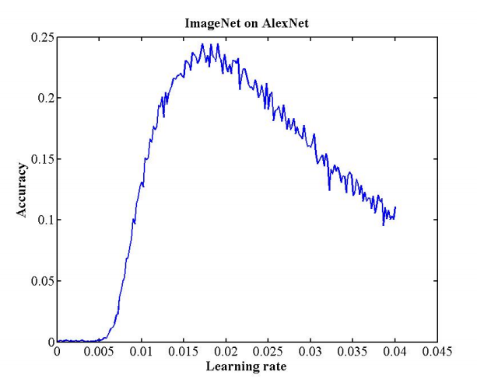
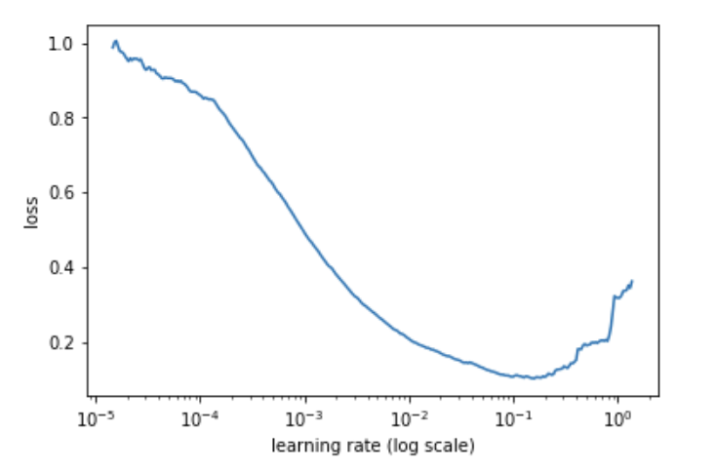
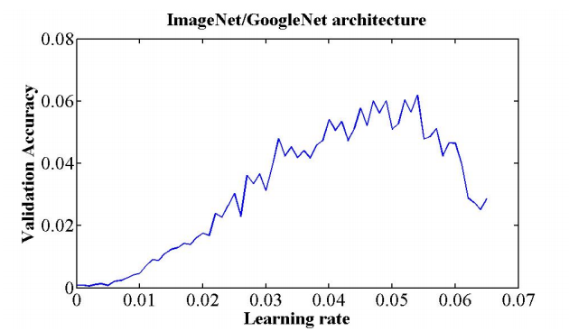
Overview: Cyclical Learning Rates for Training Neural Networks
A method for finding optimal LR proposed in CLR paper:
before you actually start training create LR range test plot
select the value of LR which leads to minimum (or maximum) in the plot
select your optimal LR to be approx. one order smaller, or ½ - ⅓ as a rule of thumb
LR=0.01
LR=0.01
LR=0.01-0.02
Implementation of LR test range is straight forward:
select number of batches, initial lr and lr multiplier
monitor loss with increasing LR
Sources:
https://sgugger.github.io/how-do-you-find-a-good-learning-rate.html

Slide 6
Overview: Cyclical Learning Rates for Training Neural Networks
Comments:
it is worth to use this method to find initial value of LR when starting with some new project
this method sounds reasonable and can be easily tested on your own problem
LR=0.01
LR=0.01
LR=0.01-0.02
Sources:
https://sgugger.github.io/how-do-you-find-a-good-learning-rate.html

Slide 7
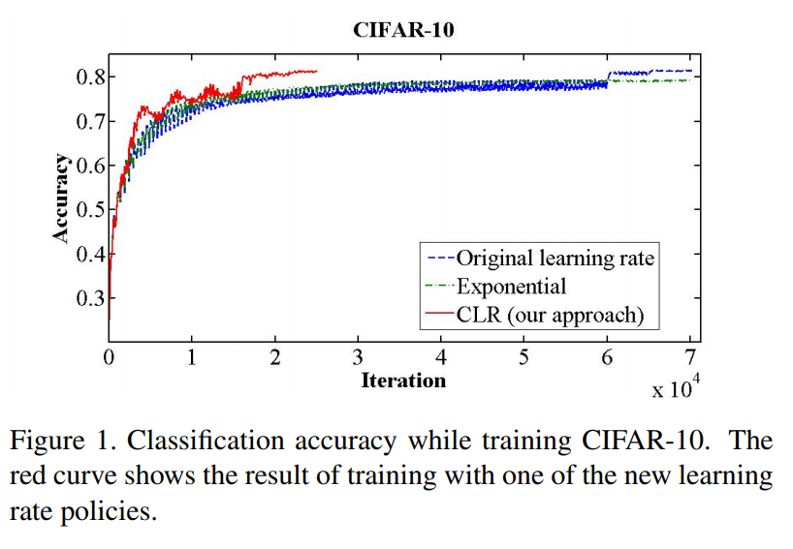
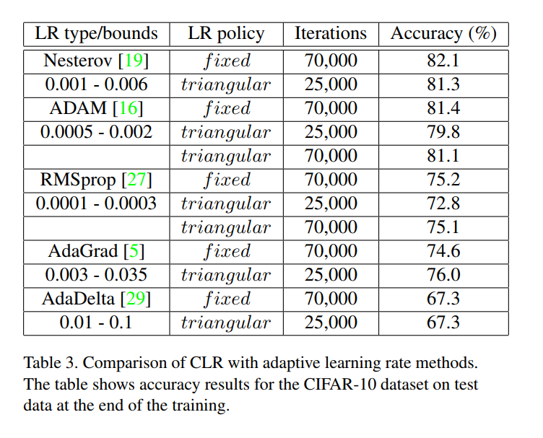
Overview: Cyclical Learning Rates for Training Neural Networks
Discussion of the results:
unfortunately, results are quite inconsistent in terms of final validation accuracy
however, it may help to tune better initial LR or even achieve faster convergence
remember, it doesn’t mean you will have better final validation accuracy
Sources:
https://sgugger.github.io/how-do-you-find-a-good-learning-rate.html

Slide 8
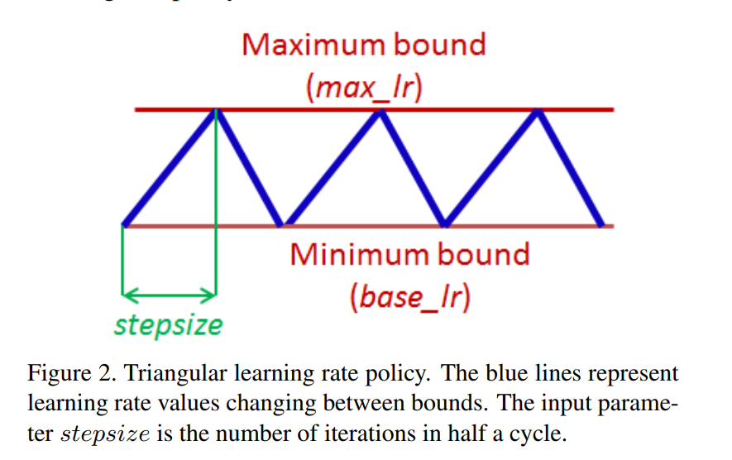
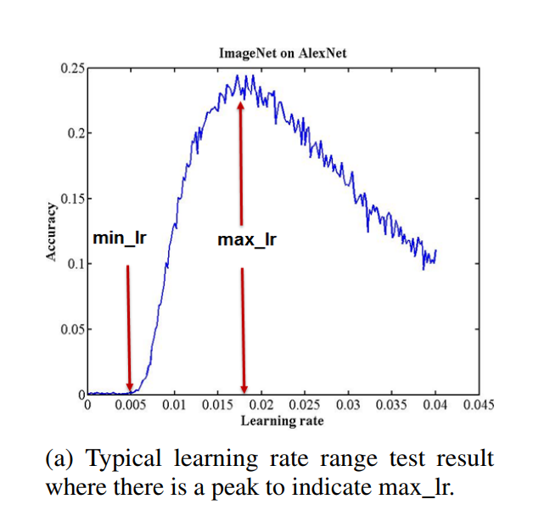
Overview: Cyclical Learning Rates for Training Neural Networks
Cyclical Learning Rates - general overview of the method
specify minimum and maximum learning rate boundaries,
stepsize is the number of iteration to reach the half of the cycle
use some policy to define the shape of the lr cycle - here example with triangular policy
Comments
it seems that the shape of the policy does not change the final result significantly,
the base_lr and max_lr can be deducted from the LR range test (see example fig),
for properly tuned LR we can reach super convergence - a phenomena where network can reach convergence for extreme values of LR

Slide 9
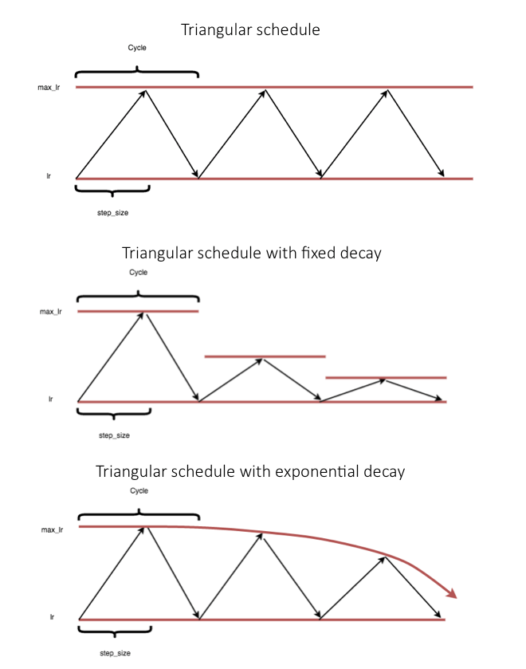
Overview: Cyclical Learning Rates for Training Neural Networks
Different policies:
Cyclical Learning Rates - general overview of the method
specify minimum and maximum learning rate boundaries,
stepsize is the number of iteration to reach the half of the cycle
use some policy to define the shape of the lr cycle - here example with triangular policy
Comments
it seems that the shape of the policy does not change the final result significantly,
the base_lr and max_lr can be deducted from the LR range test (see example fig),
for properly tuned LR we can reach super convergence - a phenomena where network can reach convergence for extreme values of LR,
more policies ...

Slide 10
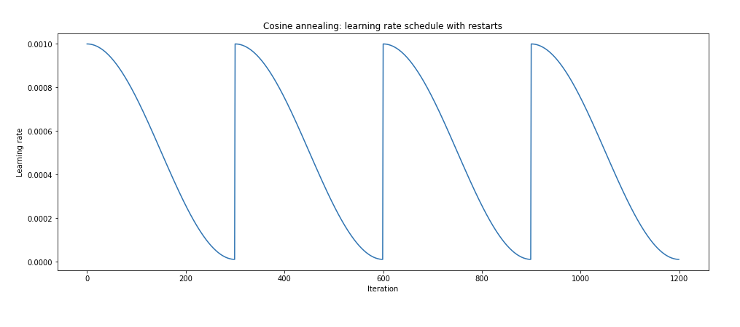
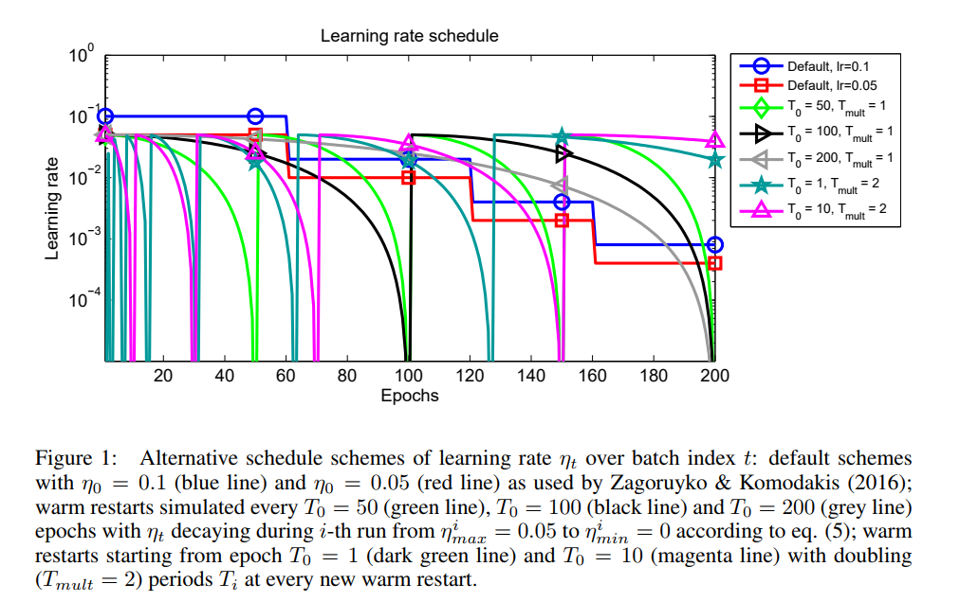
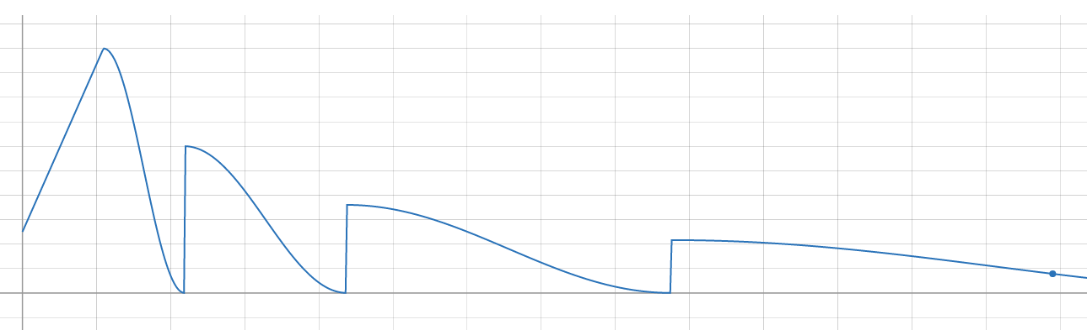
Overview: SGDR: Stochastic Gradient Descent with Warm Restarts
SGDR (2017)
In many contexts restarts in LR schedule seems to improve convergence
Warm restarts have been already used in CLR paper
It’s another paper which shows the importance of LR scheduling
Restarts with initial warmup

Slide 11
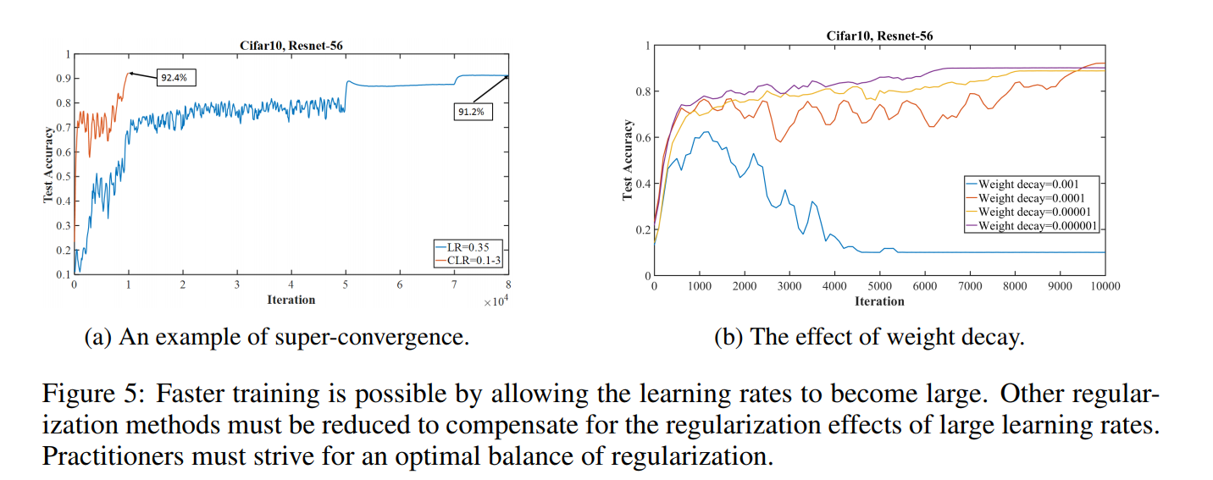
Overview: Super Convergence
Super Convergence (2018) - a phenomena where network can reach convergence for extreme values of LR. Extreme means by order of magnitude bigger than previously reported.
Comments:
larger values of LR require smaller values of other regularizations
this is because big LR already has some regularizing properties
“the amount of regularization must be balanced for each dataset and architecture”

Slide 12
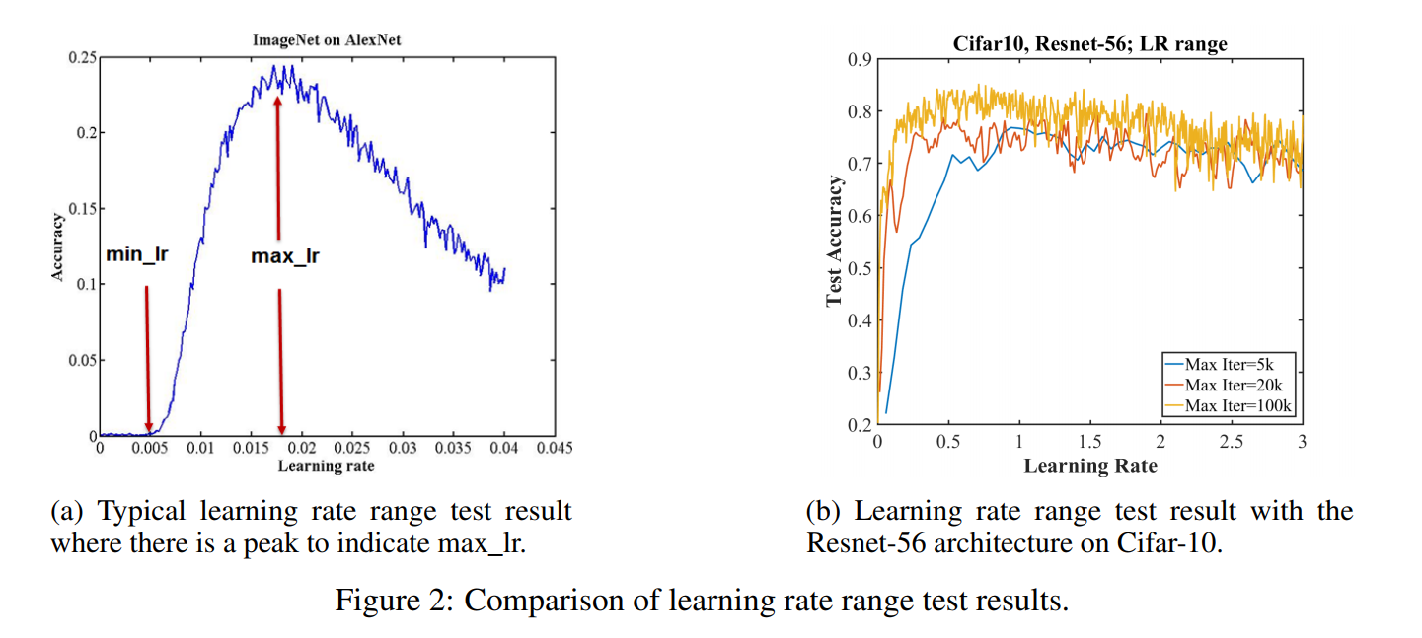
Overview: Super Convergence
Super Convergence (2018)
use LR range test to check whether SC is possible for your architecture

Slide 13
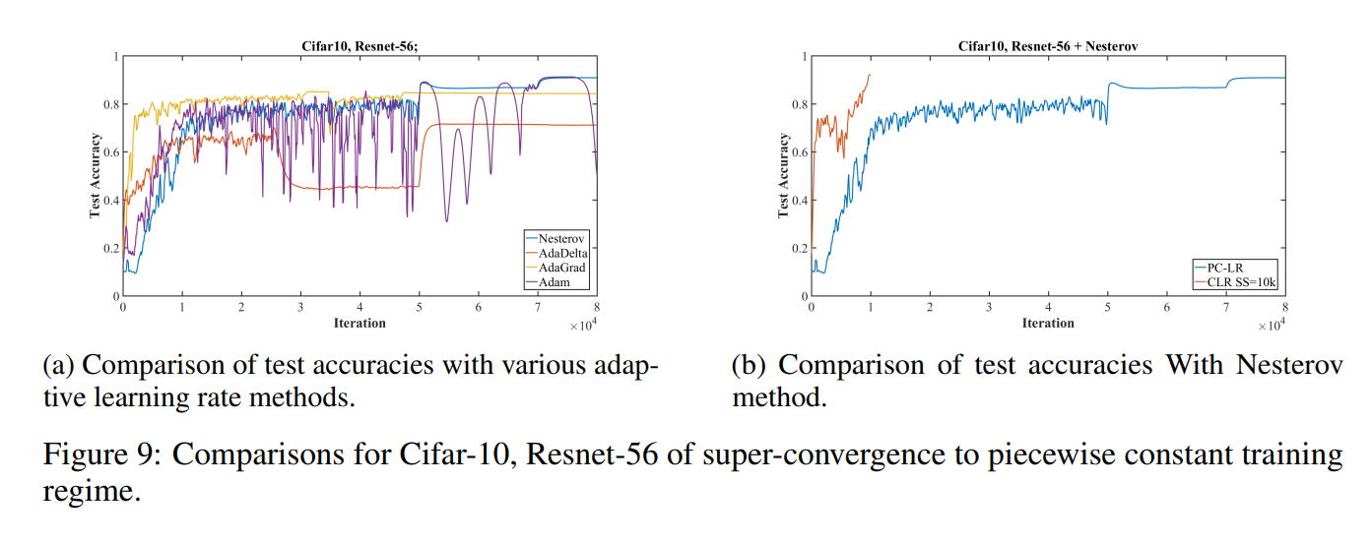
Overview: Super Convergence
Super Convergence (2018)
SC was observed for limited number of optimizers e.g. Nesterov Momentum but not for Adam
It may also depend on the architecture

Slide 14
Modifying the size of the mini-batch

Slide 15
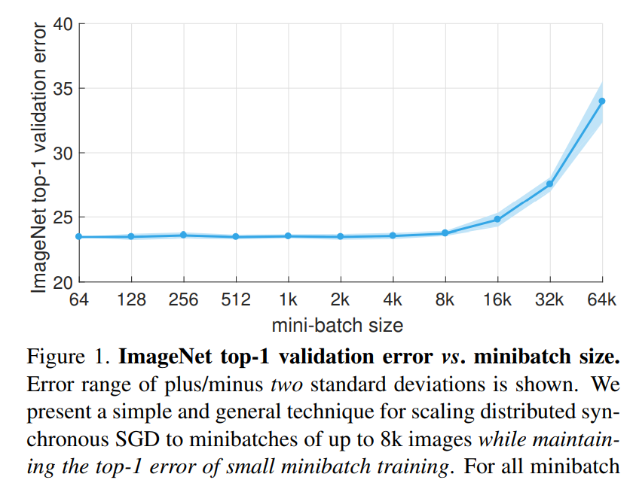
Overview: Training with extremely large batch size
Accurate, Large Minibatch SGD: Training ImageNet in 1 Hour (2018)
A common knowledge:
larger batch size more accurate gradient directions - less variance,
larger mini-batches are computationally more effective,
however, current research suggests that smaller minibatches yield better models - in terms of generalization error e.g. with simple GD you can stack at local minima, SGD helps to escape from them
on the other hand - larger mini-batches allow for taking larger steps
Same Validation error up to 8k batch size

Slide 16
Overview: Training with extremely large batch size
Accurate, Large Minibatch SGD: Training ImageNet in 1 Hour (2018)
Discussion of the paper
probably first result which showed that we can achieve good validation accuracy for extremely large mini-batches
Their solution:
linear scaling rule - scale your learning rate with mini-batch,
warmup rule - use lower learning rates at initial stage of training
With this rule their obtain: “training/validation error curves that closely match the small minibatch baseline”

Slide 17
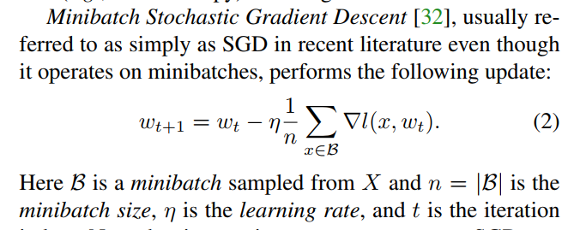
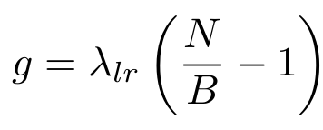
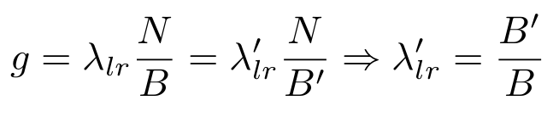
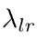
Overview: Training with extremely large batch size
Accurate, Large Minibatch SGD: Training ImageNet in 1 Hour (2018)
Motivations for the linear scaling rule
The amplitude of the noise of this gradient can be related with batch size B and the training set size N by [ref]
Quick check: when B=N there is no noise,
This noise helps to escape from local minima and improve exploration, so we want to keep it constant, when changing batch size. For N >> B we have:
k-times bigger batch size requires k-times bigger LR, to keep noise amplitude constant

Slide 18
Overview: Training with extremely large batch size
Accurate, Large Minibatch SGD: Training ImageNet in 1 Hour (2018)
Motivation for the warmup
At the beginning of the training gradients are large and training with larger LR will eventually break the training - weight explosion.
Example LR strategy with warmup:
LR
number of iterations

Slide 19
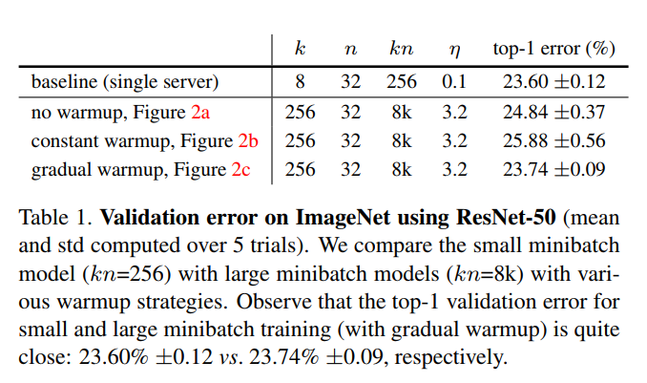
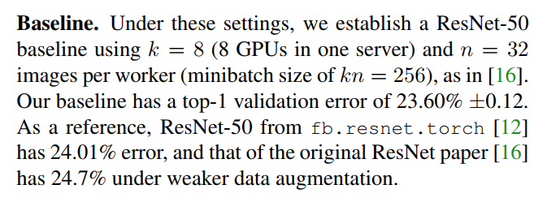
Overview: Training with extremely large batch size
Accurate, Large Minibatch SGD: Training ImageNet in 1 Hour (2018)
Importance of the warmup on the results:

Slide 20
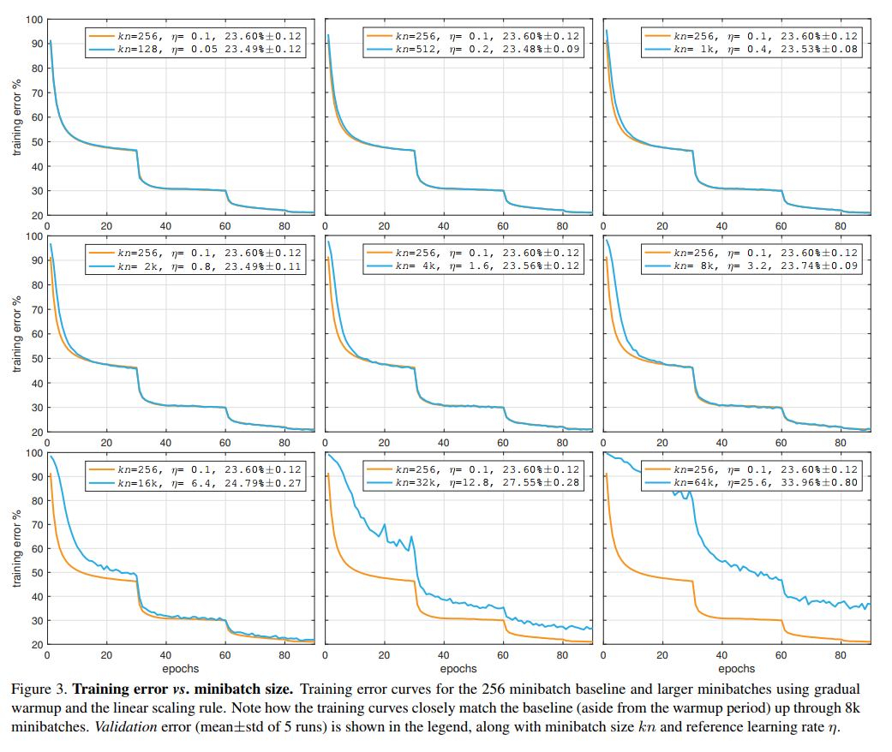
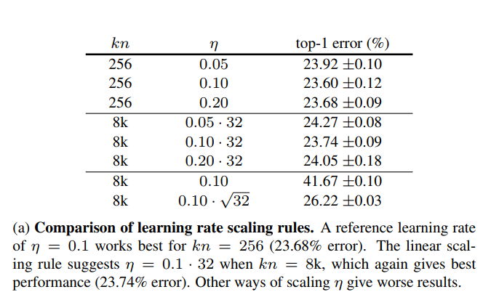
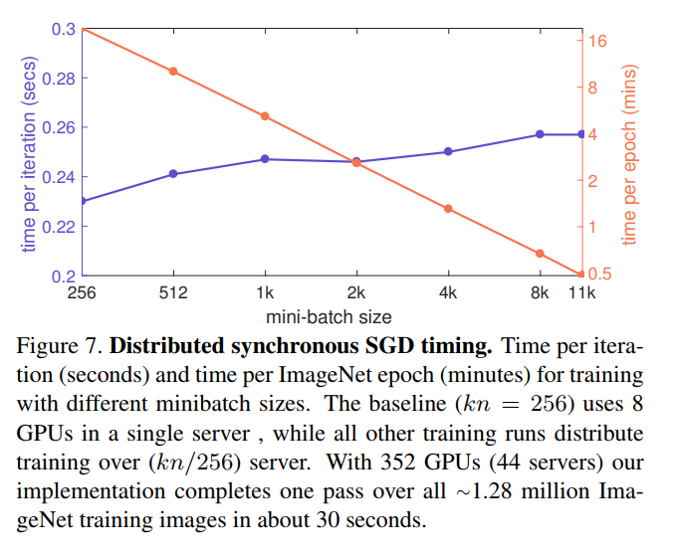
Overview: Training with extremely large batch size
Training error in function of batch size:
Scaling with larger batch size::

Slide 21
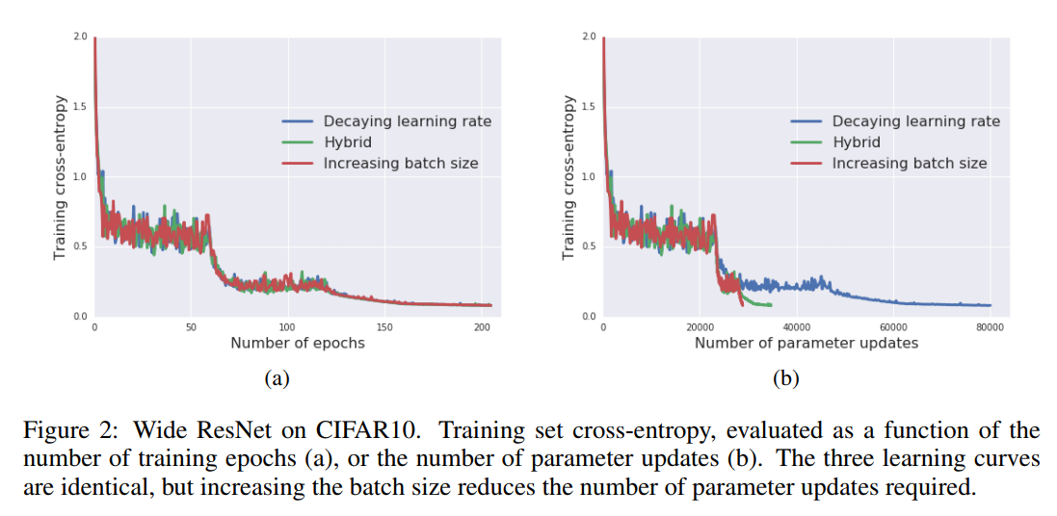
Don't Decay the Learning Rate, Increase the Batch Size (2018)
Discussion
This time ImageNet in 30 min with batch size up to 65536
Instead of decreasing learning rate by e.g. 2, increase batch size by the same amount
This will decrease gradient noise roughly by factor of 2
The results show the equivalence between those approaches
blue: decrease LR by factor 5 after some number of steps
green: increase batch size by factor 5, then decrease LR by factor 5. Repeat.
red: increase batch size by factor 5 after some number of steps.

Slide 22
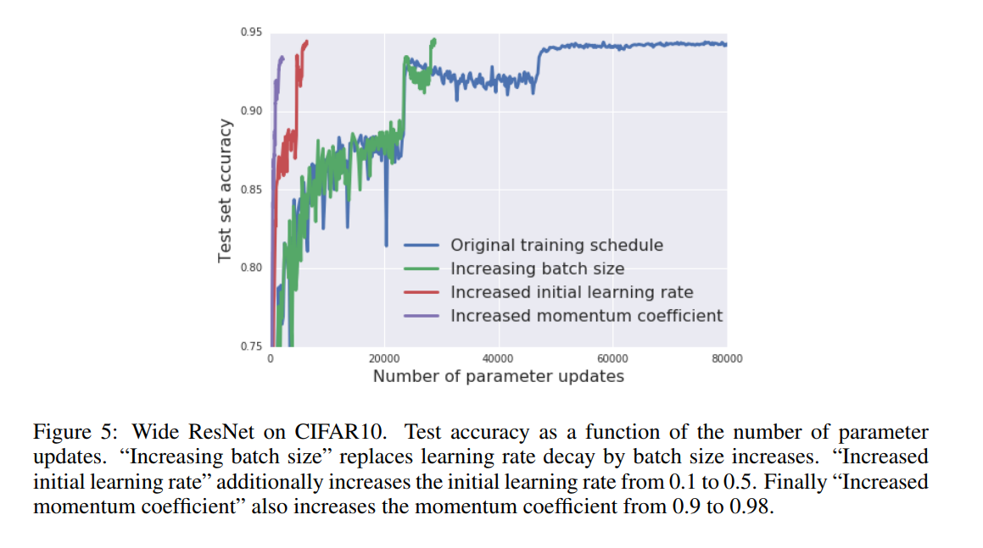
Don't Decay the Learning Rate, Increase the Batch Size (2018)
Discussion
This time ImageNet in 30 min with batch size up to 65536
Instead of decreasing learning rate by e.g. 2, increase batch size by the same amount
This will decrease gradient noise roughly by factor of 2
The results show the equivalence between those approaches

Slide 23
Some records
ImageNet ~75% accuracy in 35/100 epochs with batch size up to: 16384/131072 [NVIDIA Nov 2018]
ImageNet ~76% accuracy in 60 minutes with batch size up to 8K [Facebook 2018]
ImageNet ~75% accuracy in 15 minutes with batch size up to 32K [Preferred Networks Inc. Nov 2017]
ImageNet ~75% accuracy in 14 minutes (64 epochs) with batch size 32K [UC Berkeley et. al. 2018]
ImageNet ~75% accuracy in 224 seconds, batch size ~32K [Sony Oct 2018]
SOTA is around 81% now …

Slide 24
Modifying optimizer and weight decay

Slide 25
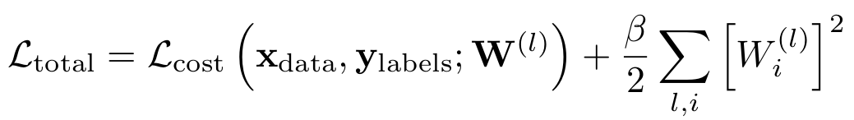
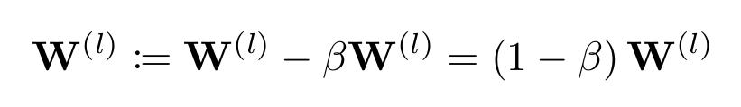
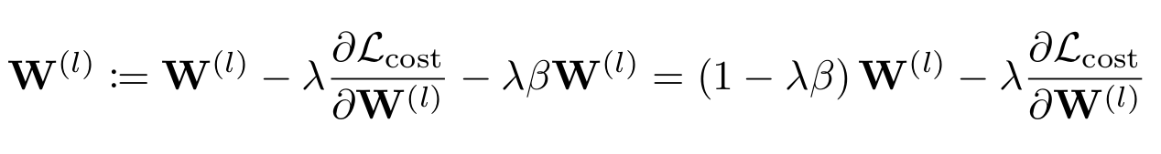
AdamW: Fixing Weight Decay Regularization in Adam (2017/2018)
Discussion: a confusion in terminology
Authors show difference between L2 and weight decay when using optimizers with adaptive learning rate e.g. Adam
According to authors (and some other people) we define L2 regularization as
l - layer number
i - i-th element of W vector
However, weight decay is defined as explicit exponential decay of parameters after each gradient step (Note: it’s not an official definition)
after each step we decrease W by 1-beta factor
Both are equivalent when we use simple SGD optimizer. This is how it is commonly defined in terms of SGD

Slide 26
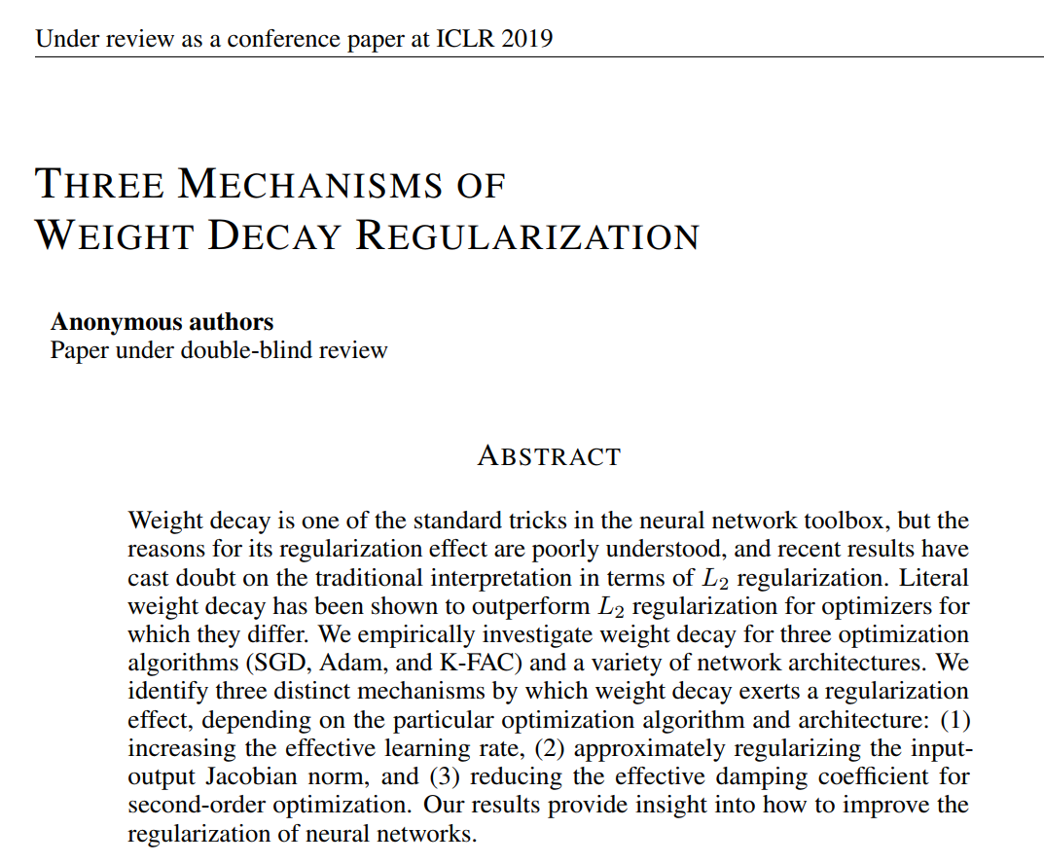
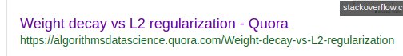
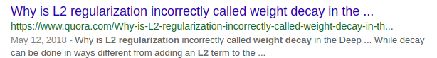
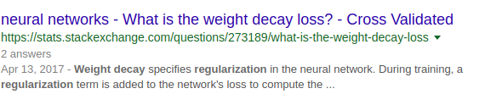
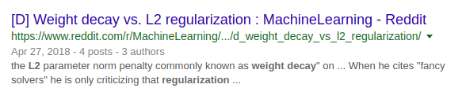
AdamW: Fixing Weight Decay Regularization in Adam (2017/2018)
Discussion: a confusion in terminology
This is quite simple thing, really?
Recent work on Weight decay (2019)

Slide 27
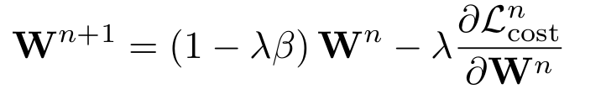
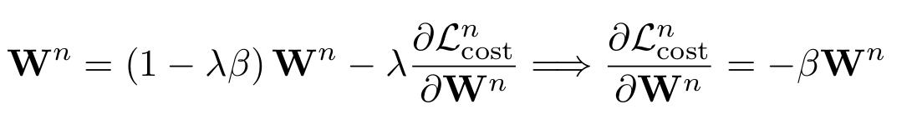
AdamW: Fixing Weight Decay Regularization in Adam (2017/2018)
Discussion: weight decay (WD) and overfitting
WD may improve generalization and final accuracy of the network,
WD decreases overfitting in two ways
it forces weights to be small, it’s a form of a soft constraint on the weights. In that sense network cannot learn arbitrary weights which would lead to zero training error
in stationary state (assuming such situation) you cannot have zero training error when using WD:
n - denotes training step, n-th batch
in stationary state weights should not change (this is a simplified picture, and stationary state should be estimated in statistical sense, additionally such stationary state may even not exist)
gradient cannot vanish during training, which will enhance exploration, however it may also cause that we will escape from the best minimum :(

Slide 28
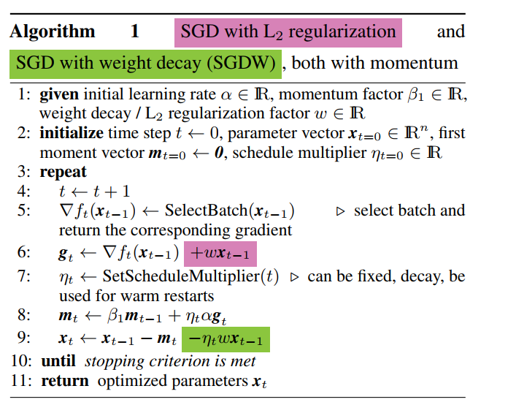
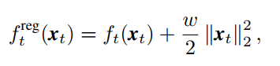
AdamW: Fixing Weight Decay Regularization in Adam (2017/2018)
Discussion: decoupling WD from gradient based update
Authors propose following change in SGD+momentum optimizer
Most frameworks add weight decay with L2 regularization i.e. by regularization term in the loss function:
Note: that x is a weight vector!

Slide 29
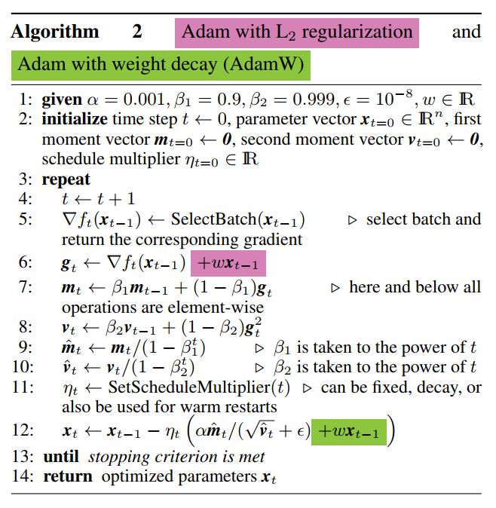
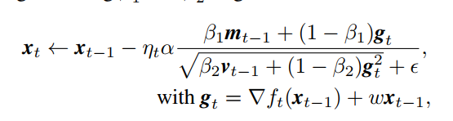
AdamW: Fixing Weight Decay Regularization in Adam (2017/2018)
Discussion: decoupling WD from gradient based update
So… the authors propose following change in Adam optimizer and call it AdamW
decoupling WD

Slide 30
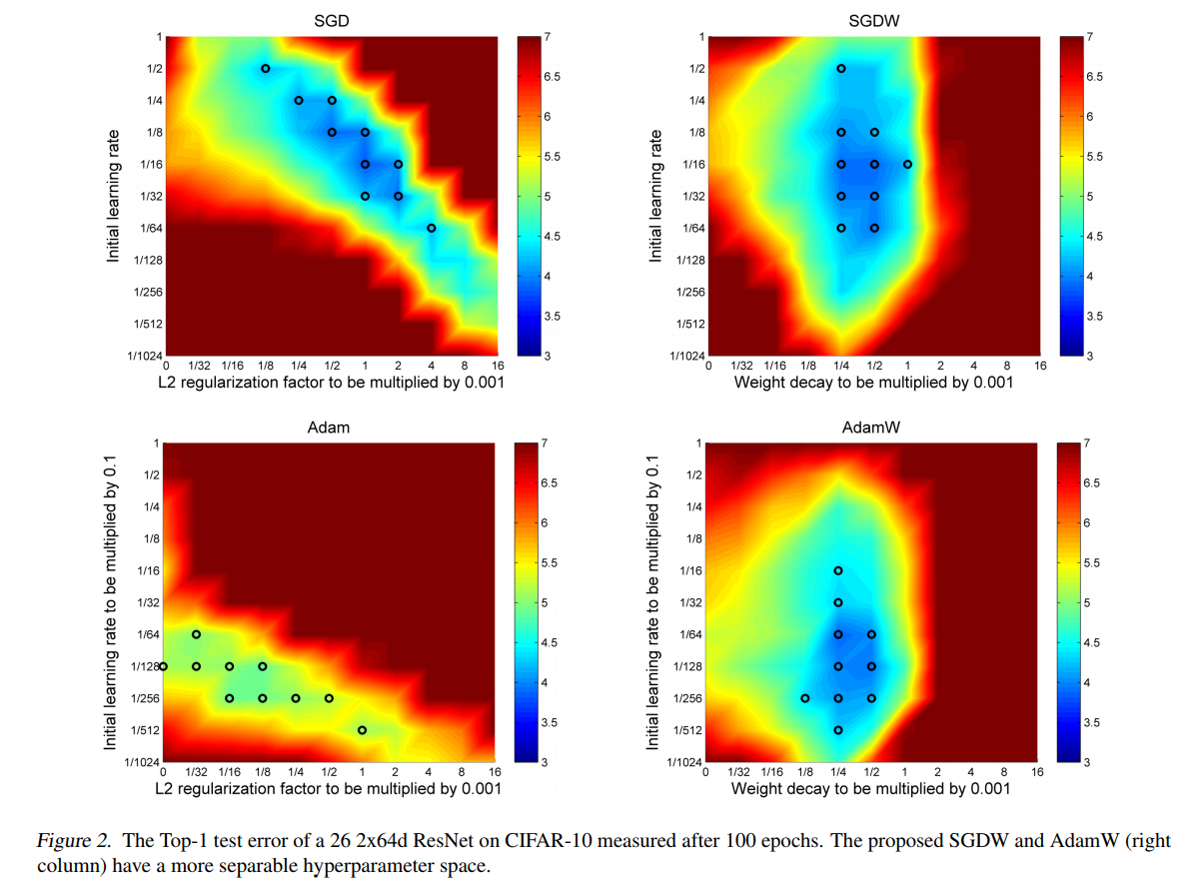
AdamW: Fixing Weight Decay Regularization in Adam (2017/2018)
Discussion: experimental results
WD and LR are coupled when using SGD and Adam optimizers,
this is not the case when using SGDW and AdamW - easier hyperparameter selection,
they observed that AdamW yield better generalization performance and smaller test error

Slide 31
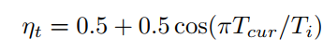
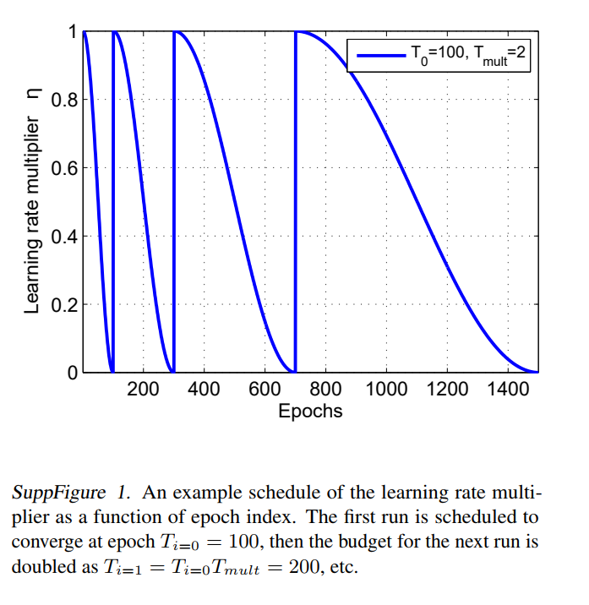
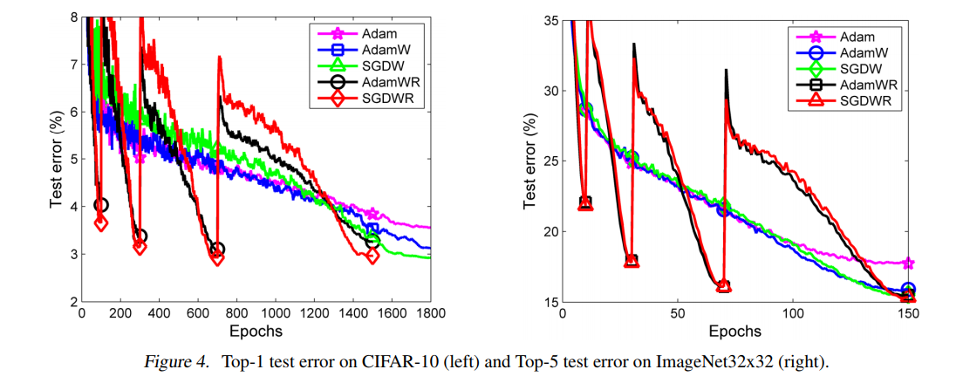
AdamW: Fixing Weight Decay Regularization in Adam (2017/2018)
Discussion: experimental results
Adam with Cosine Annealing and Warm Restarts (AdamWR):
even better performance when using AdamWR, tested on CIFAR-10 and ImageNet 32x32

Slide 32
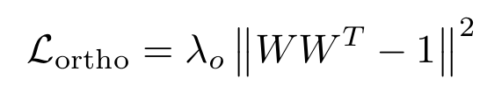
AdamW: Fixing Weight Decay Regularization in Adam (2017/2018)
Discussion: general observation
Note: WD/L2 is usually not the only thing we want to add to final loss, the problem of coupling any regularization to optimizer will also occur.
For example: orthogonalization regularization, when explicitly decoupled will lead different update when added to cost function.
Some references which use this regularization:
Neural Photo Editing with Introspective Adversarial Networks
Tunable Efficient Unitary Neural Networks (EUNN) and their application to RNNs
Orthogonal Weight Normalization: Solution to Optimization over Multiple Dependent Stiefel Manifolds in Deep Neural Networks
On orthogonality and learning recurrent networks with long term dependencies
All You Need is Beyond a Good Init: Exploring Better Solution for Training Extremely Deep Convolutional Neural Networks with Orthonormality and Modulation

Slide 33
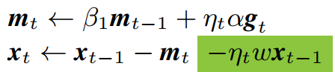
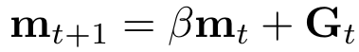
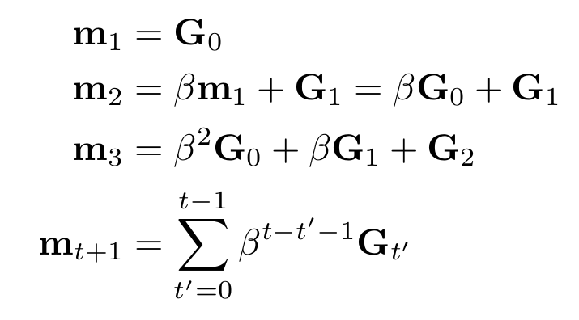
AdamW: Fixing Weight Decay Regularization in Adam (2017/2018)
Discussion: how to interpret momentum term ?
What is a difference between 0.9, 0.95 and 0.99 and 0.999 ?
Update with momentum:
this is exponential moving average
Momentum is an exponential moving average:
Let m₀ = 0

Slide 34
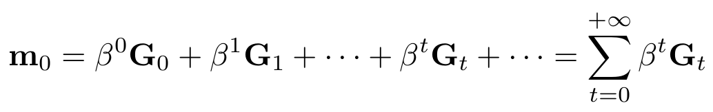


AdamW: Fixing Weight Decay Regularization in Adam (2017/2018)
Discussion: how to interpret momentum term ?
The current value of gradient is an exponentially weighted sum of the previous values
Let us change a little bit of notation, from:
to such a representation where t=0 always corresponds to the current value of averaged gradients and t>0 corresponds to the historical ones
historical values
from this, we can easily compute the number of steps after which the historical contribution of G_{t} will be smaller than e⁻¹:

Slide 35


AdamW: Fixing Weight Decay Regularization in Adam (2017/2018)
Discussion: how to interpret momentum term ?
The characteristic constant T of the exponential average, says how many steps we need to perform in order to significantly change the value of running average
Example: AdamOptimizer
Note:
consider beta=0.999, then you need about 1000 iterations to significantly change the updated vector
when you train with small number of batches you will need to decrease T
so when you may need to change the size of the batch you will have to tune the value of T

Slide 36


AdamW: Fixing Weight Decay Regularization in Adam (2017/2018)
Discussion: learning rate, batch size, weight decay are coupled
Changing one of those parameter we will change the effect of the others
We’ve already seen that when we increase batch size we should increase learning rate by the same factor.
We obtained this rule by assuming that we want to keep gradient noise amplitude constant
We can obtain the same conclusion by analysing very simple gradient descent where gradient is constant. Note: this is an extremely simplification of the problem!
After one step we move our weights by:
After K steps we will get
When using K-times bigger batch the gradient G will be approximately the same, hence in order to reach the same point after single step we need to multiply LR by K. This is a simple motivation for the linear scaling rule.

Slide 37
Summary:
Some short summary for all slides so far
choose your LR wisely
use better scheduler
remember that size of the batch is coupled with LR, changing the latter affects the former
try decoupled weight decay: tf.contrib.opt.AdamWOptimizer

Slide 38
Modifying features and labels

Slide 39
Modifying features and labels
I use the tensorflow estimators nomenclature:
features: images, text data, sounds etc...
labels: classes, boxes, segmentation masks

Slide 40


Label smoothing
An old idea proposed in: Rethinking the Inception Architecture for Computer Vision
Modify your one-hot targets with equation (original notation from paper):
K - is the number of classes
epsilon is a hyperparameter, usually 0.1
Interpretation in terms of minimized cost function: minimize standard CE with new term
standard CE
regularization term

Slide 41

Label smoothing
In tensorflow we can use: tf.losses.softmax_cross_entropy
From docs:
new_onehot_labels = onehot_labels * (1 - label_smoothing) + label_smoothing / num_classes

Slide 42






Label smoothing - motivations with toy model
As every regularization method label smoothing aims to reduce overfitting
This overfitting usually comes from the fact we train the model to be overconfident in predictions i.e. model gives extremely high scores
A toy model which shows the importance of label smoothing:
consider following classification problem with three classes
we have following features and labels pairs: {x=[1, 0, 1],y=0}, {x=[1, 0, -1],y=1}, {x=[0, 1, 0],y=2}
We create following one layer neural network:
an example matrix (with a>0) which solves this problem may have following form
each class will be correctly predicted with this matrix, however what is an optimal value for a?

Slide 43



Label smoothing - motivations
we have following features and labels pairs: {x=[1, 0, 1],y=0}, {x=[1, 0, -1],y=1}, {x=[0, 1, 0],y=2}
We create following one layer neural network:
probabilities for the first class:
cross entropy cost for the first class (same for other two classes):
Total loss:

Slide 44




Label smoothing - motivations
The final solution for a which minimizes the loss:
Consequences/properties of softmax CE:
a monotonic function with zero when scores are infinite :(
training for a longer times will make weights go to the infinity or very large values i.e. longer training may make your model overfit easier :(
overconfidence in scores i.e. model returns 0 and 1 values - a nice signal of overfitting :(
an optimal solution ...
What about label smoothing (eps=0.1) ?
image source
There is a local minimum now i.e. we reduce overconfidence of the model! Training for longer times can be also much safer

Slide 45

Label smoothing - motivations
The final solution with LS for a which minimizes the loss:
loss versus label smoothing parameter

Slide 46

Label smoothing - results
The results show that using label smoothing may improve trained model,
The cost of adding this regularization is minimal, so definitely one should try it in its own experiments
Note: when using label smoothing, you loss will be much larger now, however your metrics like accuracy should improve.
Minimum loss value increases with epsilon
You can find more experiments in following, not accepted ICLR 2017, paper:
Regularizing Neural Networks by Penalizing Confident Output Distributions
This paper introduces similar method which is compared among others with label smoothing in various experiments.
What is important that LS yields improvement w.r.t baseline in all of them

Slide 47

Label smoothing - softmax and final remarks
We have arbitrarily guess the solution of our problem: {x=[1, 0, 1],y=0}, {x=[1, 0, -1],y=1}, {x=[0, 1, 0],y=2}
with matrix:
which gives following loss:
but there is an infinite many W which will give exactly the same final loss e.g.
this form of solution completely neglects some of the input values of vector x,
inputs of form [1, alpha, beta] will give exactly the same predictions for any alpha and beta,
this can be viewed as a form of information compression, model will learn the easiest interpretation for the input data (from training set)
consider dataset of cars where every sport car is red, it is clear the model will learn to distinguish between sport car and regular one by its color.

Slide 48
Modifying features and labels: mixup

Slide 49





mixup: Beyond Empirical Risk Minimization (ICLR 2018)
an idea: mix features and labels with linear interpolation
beta distribution

Slide 50
mixup: Beyond Empirical Risk Minimization (ICLR 2018)
an idea: mix features and labels with linear interpolation
mixup:
mixup is an extremely strong regularizer
a form data augmentation,
according to authors learned manifold is smoother: see toy model example

Slide 51



mixup: Beyond Empirical Risk Minimization (ICLR 2018)
selected results:
note dependency on the architecture, this is actually bad sign

Slide 52
Modifying initial conditions

Slide 53


Residual Learning Without Normalization via Better Initialization
(ICLR 2019)
A better initialization and network construction allows one to remove normalization layers and train deep neural networks,
According to authors: All you need to train deep residual networks is a good initialization; normalization layers are not necessary,
Paper is under review process,
they propose ZeroInit method of network initialization. They train ResNet up to 10000 layers.
The authors tackle following problems/benchmarks:

Slide 54

Residual Learning Without Normalization via Better Initialization
(ICLR 2019)
An overview of architecture

Slide 55

Residual Learning Without Normalization via Better Initialization
(ICLR 2019)
The authors show that at initialization the variance of activations grows exponentially with depth (when there is no normalization in the network)
The idea is to construct such network which will have desired properties at initialization e.g. no exploding and vanishing activations with depth
L - is the number of residual blocks
m - number of layers inside block
Note: Authors provides theorems which justify this choice, see paper for more details.

Slide 56

Residual Learning Without Normalization via Better Initialization
(ICLR 2019)
Selected results:
CIFAR-10 test accuracy after first epoch for different initialization schemes
high learning rate 0.1,
I’m not sure if LSUV baseline was done properly (it should be done for every layer, but authors did it for the output of residual block): “post-process an orthogonal initialization such that the output variance of each residual block is close to 1”

Slide 57

Residual Learning Without Normalization via Better Initialization
(ICLR 2019)
Selected results:
A check whether deviation from theoretical initialization decreases performance.

Slide 58

Residual Learning Without Normalization via Better Initialization
(ICLR 2019)
Selected results:
Image classification: ZeroInit requires additional regularization

Slide 59

Residual Learning Without Normalization via Better Initialization
(ICLR 2019)
Selected results:
Image classification: ZeroInit requires additional regularization,
Normally we have additional regularization from batchnorm,

Slide 60
Shake-shake regularization

Slide 61


Shake-Shake regularization (2017) - a motivation to try this method
From paper: Do CIFAR-10 Classifiers Generalize to CIFAR-10?
they authors tested the accuracy of a larger number of SOTA models on new CIFAR-like dataset
they asked: How reliable are our current measures of progress in machine learning?
they found that: The top model is still a recent Shake-Shake network with Cutout regularization
all models had linear drop in test accuracy

Slide 62

Shake-Shake regularization (2017)
Shake-Shake regularization is a regularization method proposed for ResNet architectures
Basic idea: a random augmentation on the hidden activation level, instead of features
Results and detailed discussion can be found in paper

Slide 63
Summary: “Bag of Tricks for Image Classification with Convolutional Neural Networks“

Slide 64



Bag of Tricks for Image Classification with Convolutional Neural Networks (2018) (Amazon)
Standard training pipeline:
for more details about input preprocessing used for the baseline models check section: 2.1. Baseline Training Procedure

Slide 65

Bag of Tricks for Image Classification with Convolutional Neural Networks (2018)
Tricks for large-batch training:
Linear scaling learning rate (already discussed)
Learning rate warmup (already discussed)
zero gamma in batch norm (x*gamma + bias) (resnet branch reduces to identity function) (already discussed in ZeroInit method)
No bias decay - do not apply L2 (or weight decay) to bias tensors (gamma and bias in BN too)
2. Use low precision training: use float 16 instead float 32 to speed up computations (this will depend on GPU)
keep activations and updates at 16bit precision
keep weights in 32bit -> this is to reduce overflow problem

Slide 66


Bag of Tricks for Image Classification with Convolutional Neural Networks (2018)
3. Architecture tweaks (simple changes as model stride, pooling layer etc)
They introduce B-C-D variants of ResNet blocks

Slide 67

Bag of Tricks for Image Classification with Convolutional Neural Networks (2018)
3. Architecture tweaks (simple changes as model stride, pooling layer etc)
They introduce B-C-D variants

Slide 68



Bag of Tricks for Image Classification with Convolutional Neural Networks (2018)
4. Training Refinements:
Cosine Learning Rate Decay (already discussed)
Label Smoothing (already discussed)
Knowledge Distillation - train student Net (a smaller one) by forcing similar softmax activations with teacher Net (the bigger one): z is student, r is teacher
Mixup Training (already discussed)

Slide 69


Bag of Tricks for Image Classification with Convolutional Neural Networks (2018)
Object detection (left) and segmentation (right)
In the case of Object detection: ”The VGG-19 base model in Faster-RCNN is replaced with various pretrained models in the previous discussion”
discussed in paper: smoothing in segmentation may be not the best ides

Slide 70
Questions?

Slide 71
References:
Learning rate and batch size:
A disciplined approach to neural network hyper-parameters: Part 1 -- learning rate, batch size, momentum, and weight decay
Cyclical Learning Rates for Training Neural Networks
[BLOG] The 1cycle policy
Super-Convergence: Very Fast Training of Neural Networks Using Large Learning Rates
SGDR: Stochastic Gradient Descent with Warm Restarts
[BLOG] Learning rate
Accurate, Large Minibatch SGD: Training ImageNet in 1 Hour
Don't Decay the Learning Rate, Increase the Batch Size
Second-order Optimization Method for Large Mini-batch: Training ResNet-50 on ImageNet in 35 Epochs

Slide 72
References:
Optimizers and weight decay
Fixing Weight Decay Regularization in Adam (2018)
Three Mechanisms of Weight Decay Regularization (2018)
Features and labels
Rethinking the Inception Architecture for Computer Vision (2015)
Regularizing Neural Networks by Penalizing Confident Output Distributions (2017)
mixup: Beyond Empirical Risk Minimization (2018)
Initialization:
Residual Learning Without Normalization via Better Initialization (2018)
Others:
Do CIFAR-10 Classifiers Generalize to CIFAR-10? (2018)
Shake-Shake regularization (2017)
Bag of Tricks for Image Classification with Convolutional Neural Networks (2018)

Slide 73


